Slide 1
Project
“criminal detection system using ml
Group Members:
Mahtab
Saurabh
Keshav
Pradum
nirendra

Slide 2
Idea Description
The project idea is to use machine learning and artificial intelligence in police functioning
The main objective of project is to make a full functioning software which can be used by police to investigate any case and will help police in reducing crime.
Features in this software:-
* Real Time Suspect Detection
* Crime Analysis
* Language Translation

Slide 3
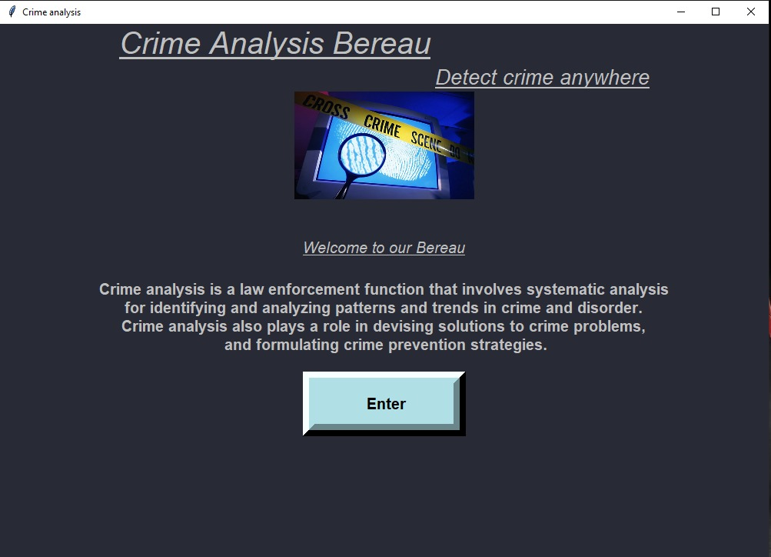
WELCOME TO CRIME ANALYSIS BUREAU!!!

Slide 4
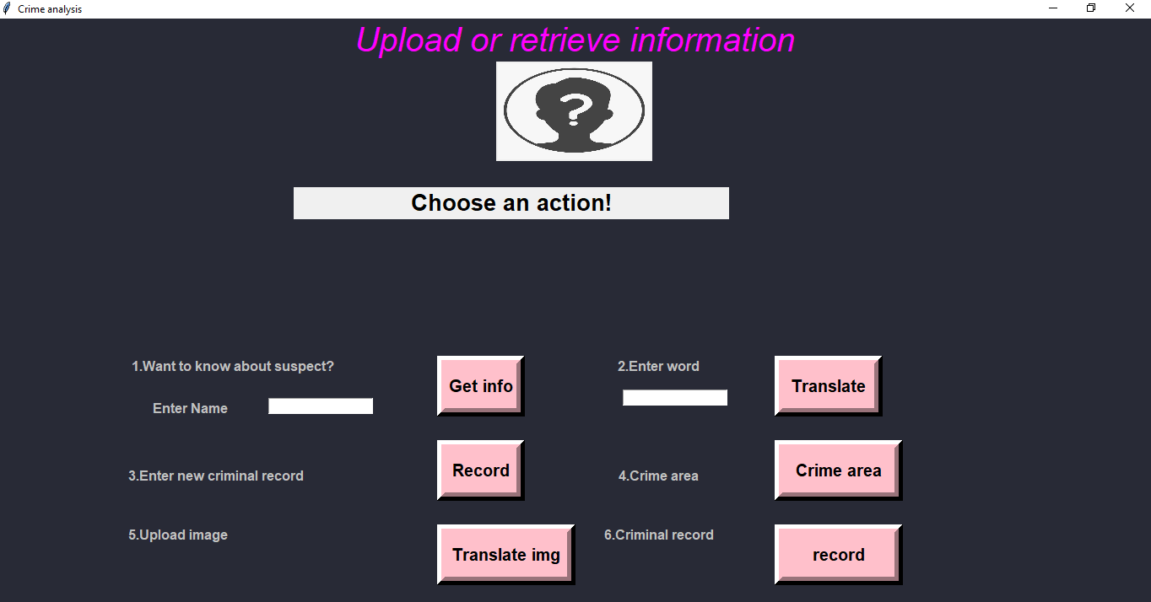
GUI OF OUR SOFTWARE

Slide 5
Technology Stack
Deep Learning
Python pandas and numpy library
Computer Vision and image processing

Slide 6
Real time Suspect Tracing
Many a times ,police gets to know about the suspect but they are unable to find them.
They have to ask to different peoples that whether they had seen the suspect.
Sometimes they are not able to trace suspect using its mobile phone location as mobile phone is switched off of the suspect.
Real time Suspect tracing will led the software to get connected with CCTV cameras.
When CCTV cameras will detect the suspect it will send the real time location of suspect to police.
For this CCTV camera will be customized and will be programmed with deep learning algorithms

Slide 7
Crime prone area analysis
Crime analysis will help the police to detect the areas which have higher probability of the crime occurrences.
This will led police to increase the surveillance in that area which will help to prevent the crime.
For this crime dataset of the city will be trained with machine learning algorithms through predictions of the highly probable areas will be predicted.
And this will led police to increase the surveillance in that particular area thus easing their job and will help in crime reduction.

Slide 8
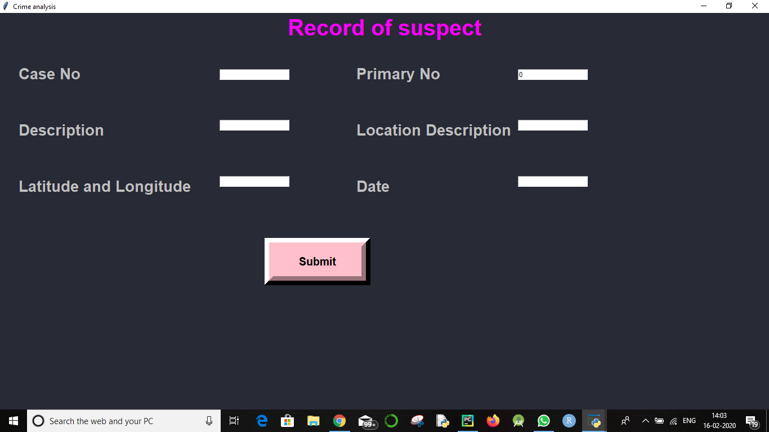
Adding Data of Crime

Slide 9
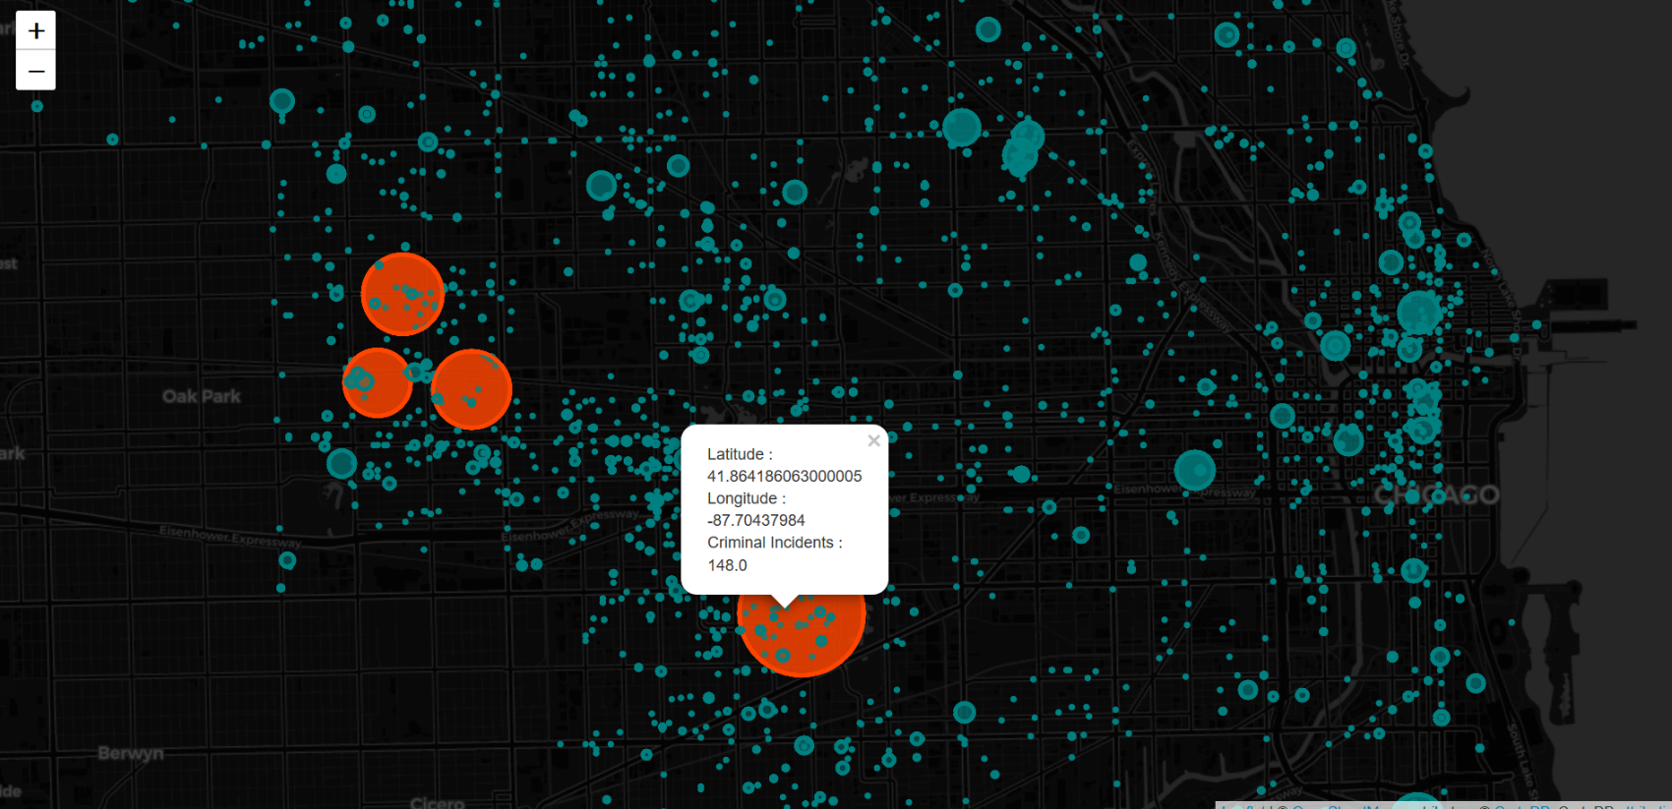
Map will show the crime analysis of area. Larger the circle more crime prone area.

Slide 10
Natural language processing on Indian languages:
There are 22 official languages of India which includes languages like Assamese, Kannada, Bengali and so on.
NLP will help to translate these languages in some other languages which local police can understand
For eg- If from a crime scene police gets a letter written in Bengali. It will help to convert this into some common language like English through which police will be able to understood what is written in the letter.
Also NLP will be integrated with image processing to convert text in the image into understandable form for police.

Slide 11
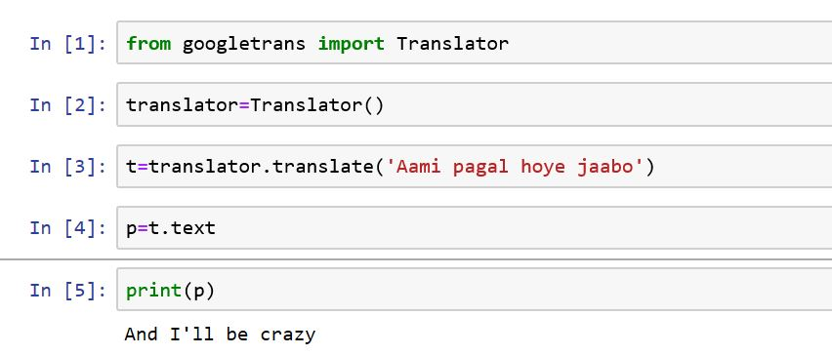

Slide 12
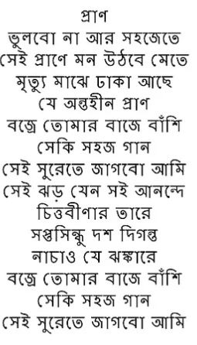
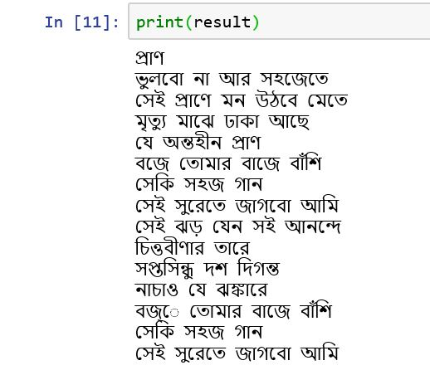
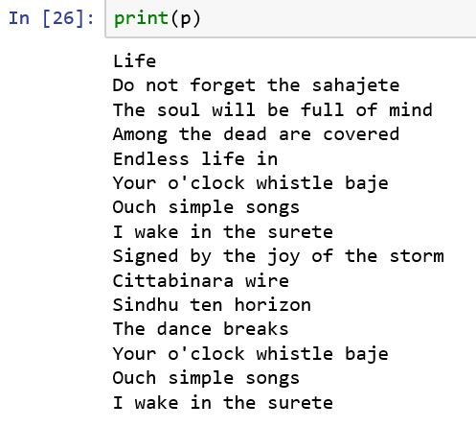
LANGUAGE TRANSLATION
Converting Bengali into English

Slide 13
THANK YOU!!!!

